Slide 1
Where is the missing person?
Pariya Samandi (UID: 205-092-357)
Stewart Dulaney (UID: 904-064-791)
December 03, 2019

Slide 2
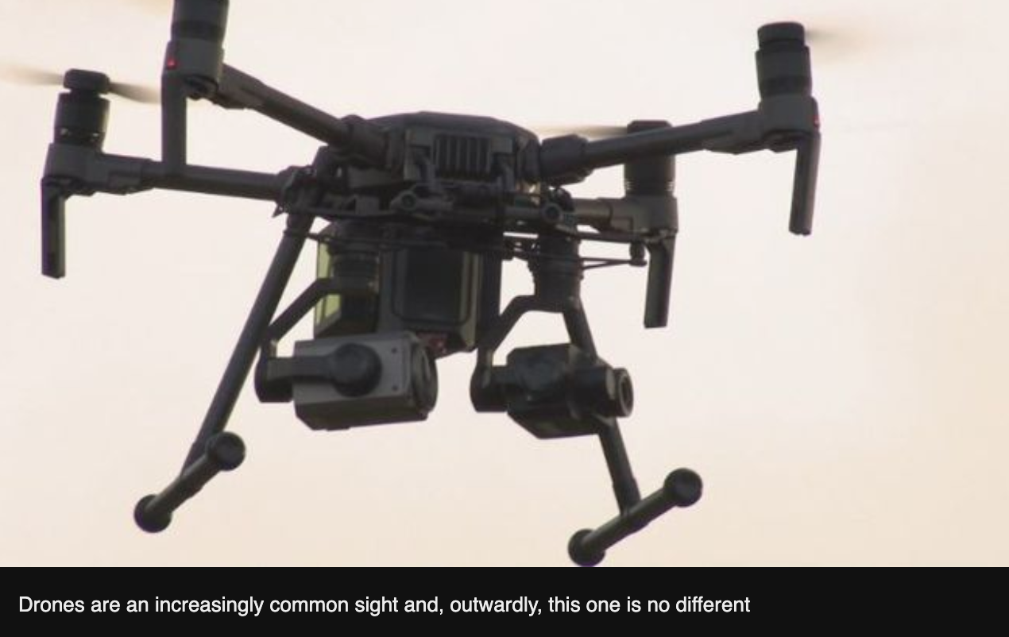
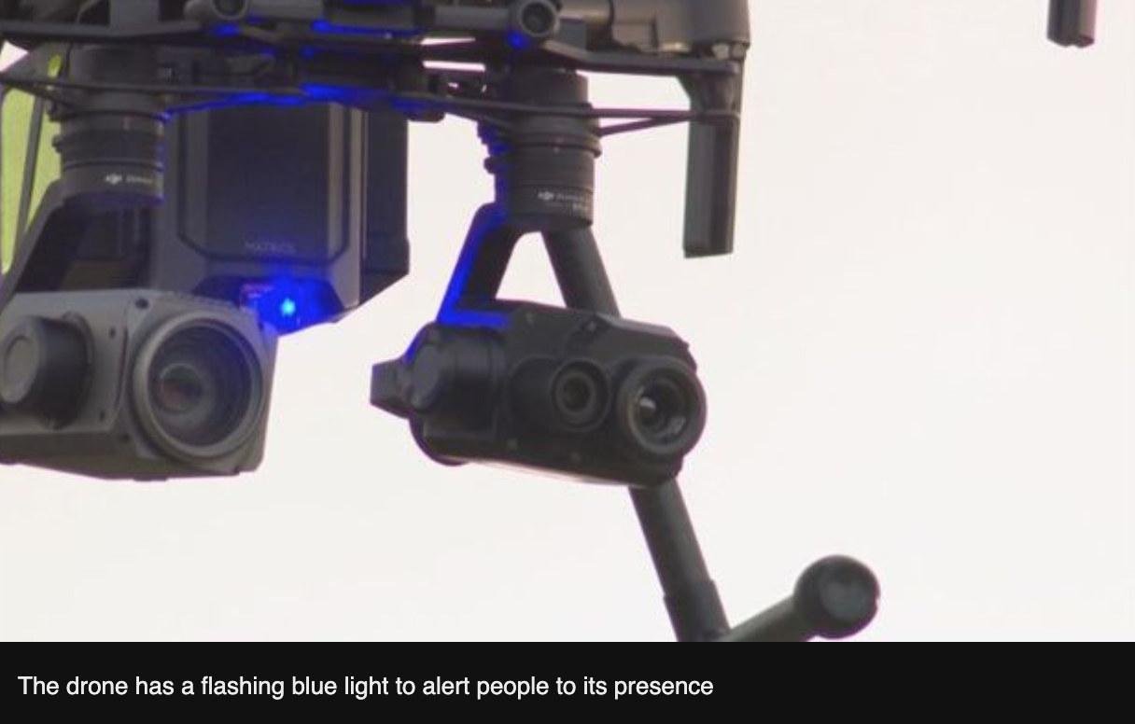
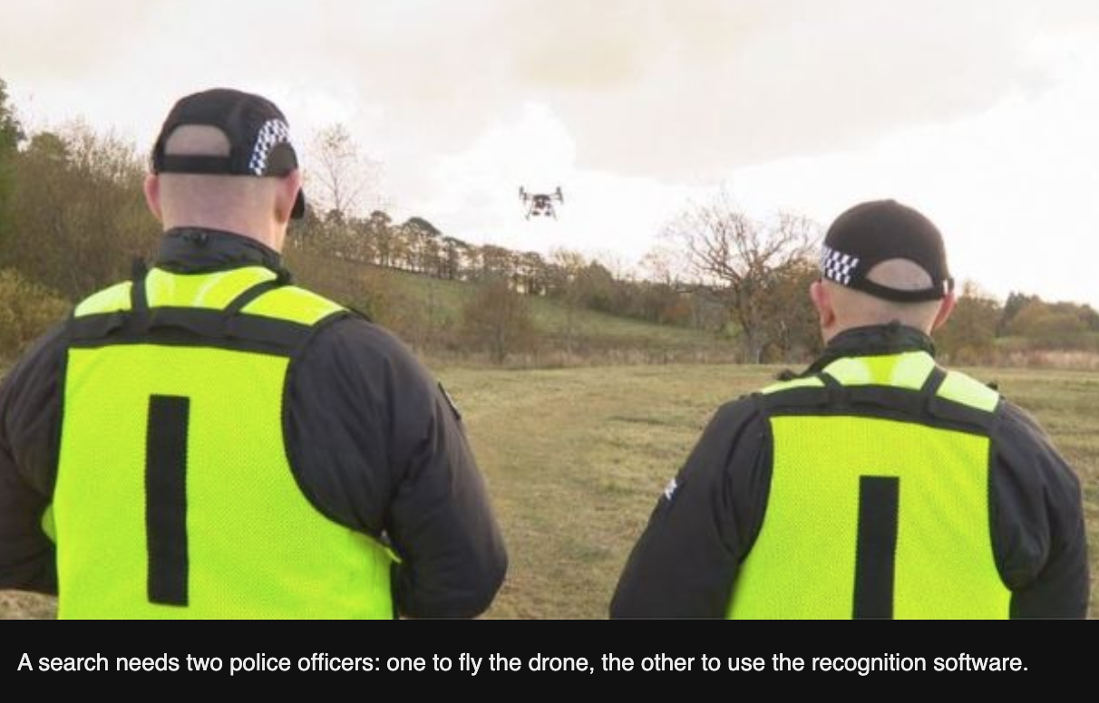
Drones

Slide 3
Introduction
Scotland Police has revealed an aerial drone system to find missing people
It uses advanced technologies like highly-powered optical cameras, neural networks, thermal imaging sensors, and Internet of Things devices.

Slide 4
Introduction
The low cost drone uses can be operated by two people, one for flying the drone and another one for using the recognition software (Macdonald).
The program falls short in preserving privacy by failing to protect potentially sensitive data captured.

Slide 5
Usability
The RPAS is capable of gathering data in real-time
RPAS is both technology-centered and user-centered.
Designers have considered the end-user (human) needs per Nielsen’s usability Heuristic Evaluation (HE)

Slide 6
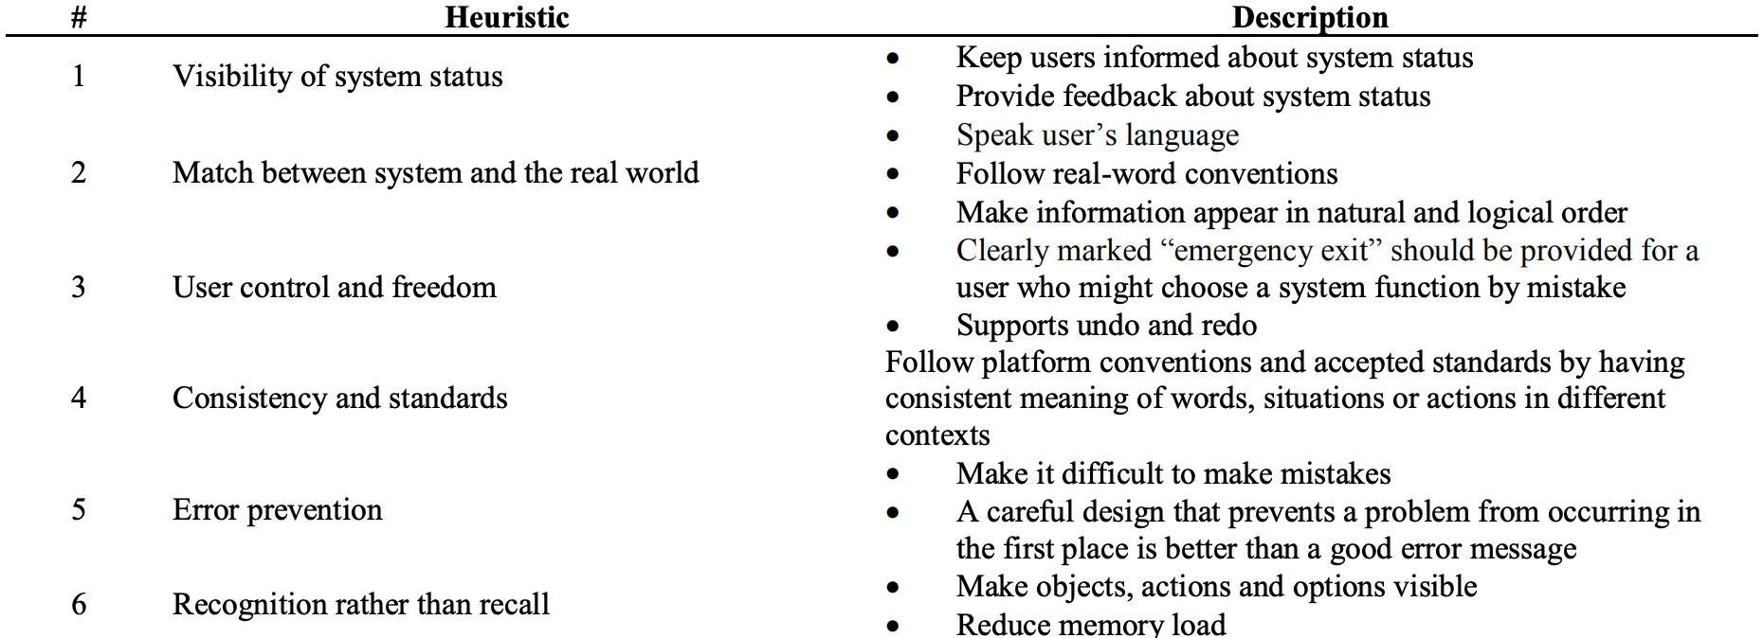
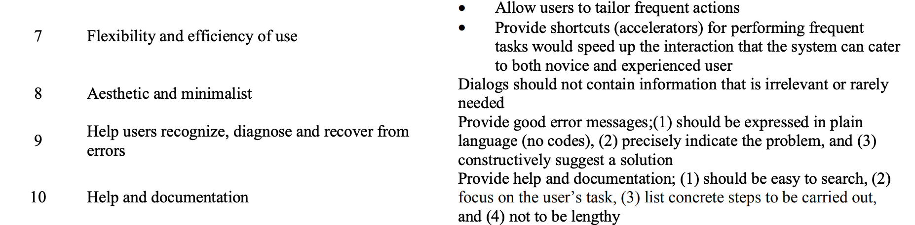
Nielsen’s Heuristics for Expert Evaluation

Slide 7



Applications - Police Scotland
In addition to finding missing persons:
Crime Scenes | Unsafe Situations | Events

Slide 8



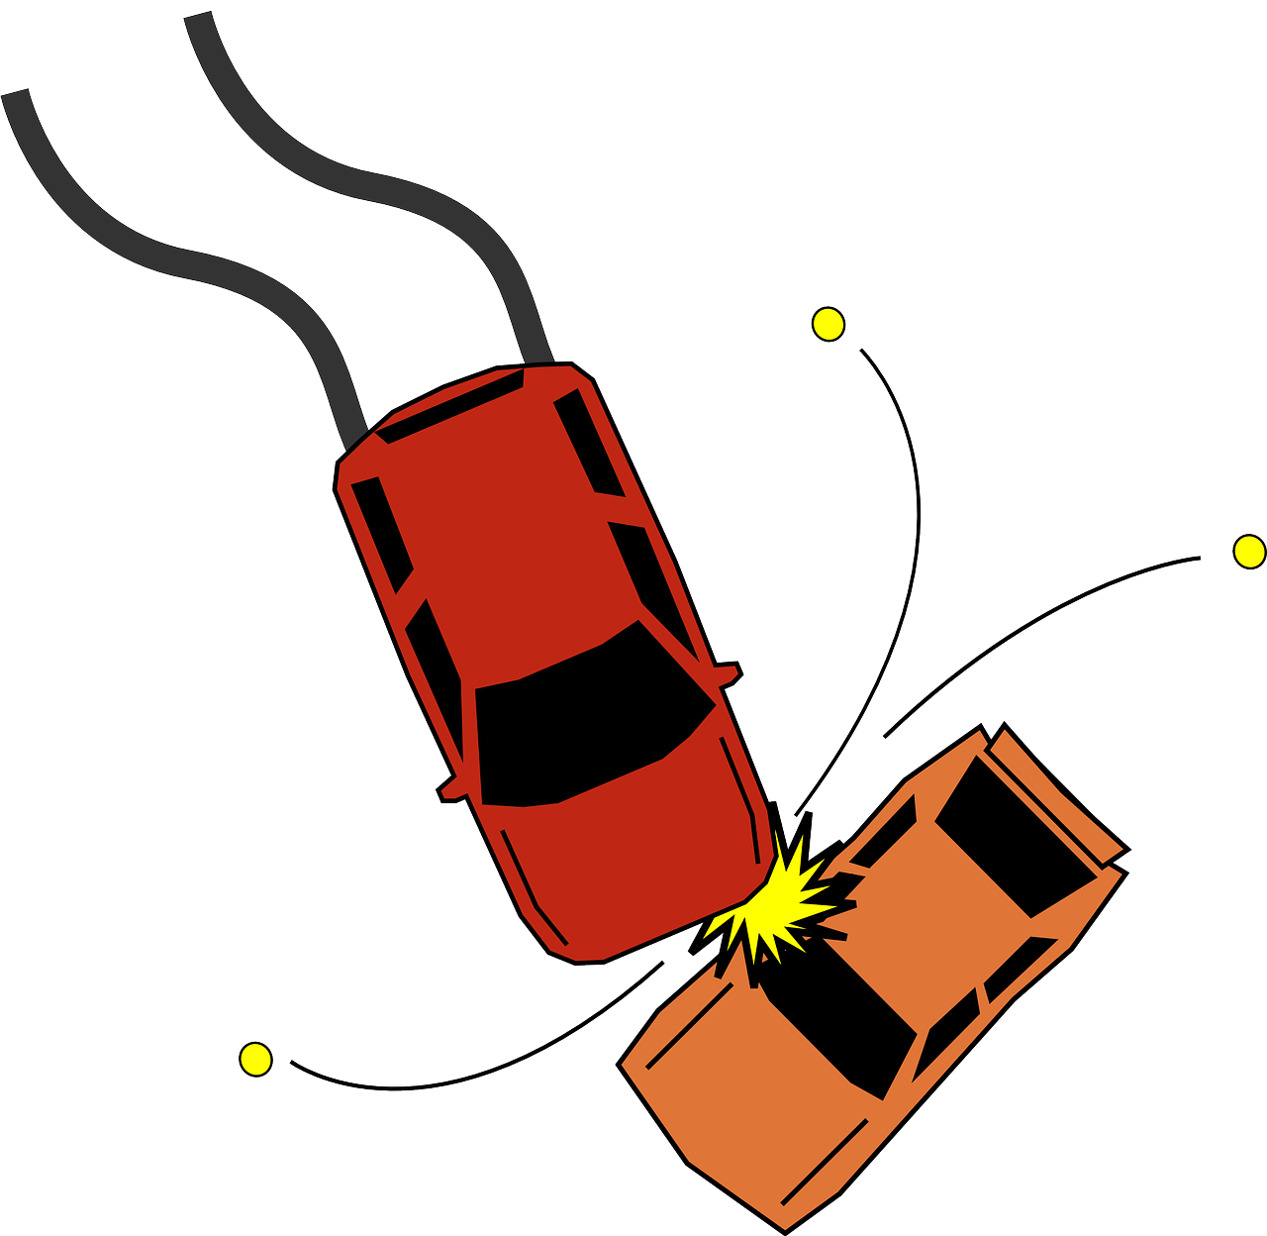

Applications - Broader Law Enforcement
Safeguard VIP’s | Detect Crime | Evaluate Disasters | Detect Hotspots | Car Accidents

Slide 9
Applications - Many More
Sensors - Police Scotland | Add’l Sensors or Tools
Daytime video camera Thermal image camera | Air quality sensors Pepper spray Cell phone trackers Etc

Slide 10
Privacy - The Good
Data Protection Impact Assessment
United Kingdom
GDPR

Slide 11
Privacy - Flow of Personal Data
Camera
Radio
SD Card
CD

Slide 12
Privacy - The Bad
1
No encryption
2
No auditable access logs

Slide 13
Thank You

